Slide 1

Chapter 3
Data and Signals
3.‹#›
Copyright © The McGraw-Hill Companies, Inc. Permission required for reproduction or display.

Slide 2

Note
To be transmitted, data must be transformed to electromagnetic signals.
3.‹#›

Slide 3
3-1 ANALOG AND DIGITAL
Data can be analog or digital. The term analog data refers to information that is continuous; digital data refers to information that has discrete states. Analog data take on continuous values. Digital data take on discrete values.
Topics discussed in this section:
Analog and Digital Data
Analog and Digital Signals
Periodic and Nonperiodic Signals
3.‹#›

Slide 4
Note
Data can be analog or digital.
Analog data are continuous and take continuous values.
Digital data have discrete states and take discrete values.
3.‹#›

Slide 5
Note
Signals can be analog or digital.
Analog signals can have an infinite number of values in a range; digital signals can have only a limited
number of values.
3.‹#›

Slide 6
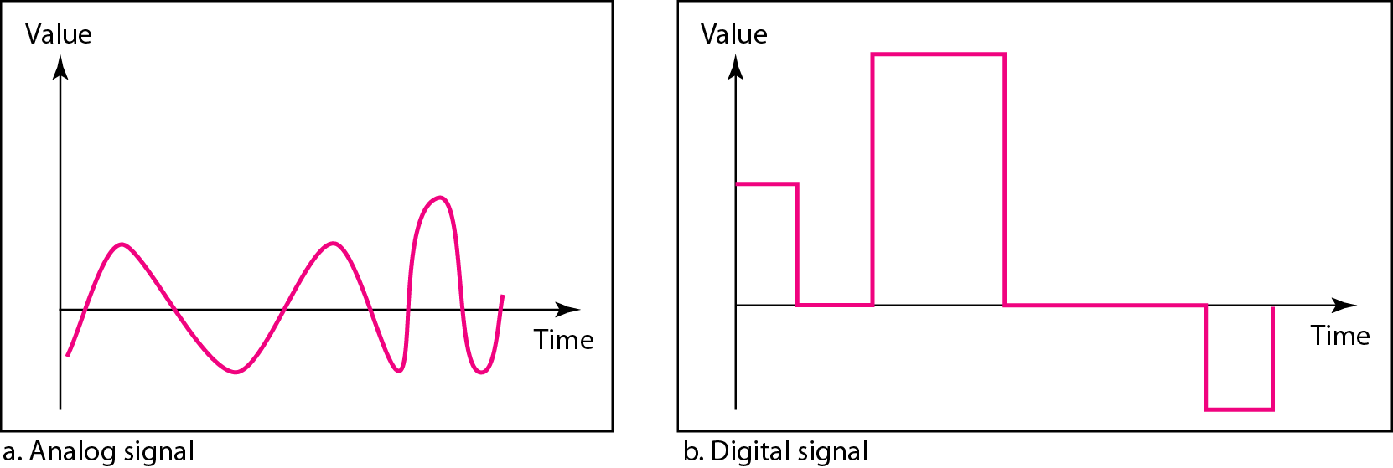
Figure 3.1 Comparison of analog and digital signals
3.‹#›

Slide 7
Note
In data communications, we commonly use periodic analog signals and nonperiodic digital signals.
3.‹#›

Slide 8
3-2 PERIODIC ANALOG SIGNALS
Periodic analog signals can be classified as simple or composite. A simple periodic analog signal, a sine wave, cannot be decomposed into simpler signals. A composite
periodic analog signal is composed of multiple sine waves.
Topics discussed in this section:
Sine Wave
Wavelength
Time and Frequency Domain
Composite Signals
Bandwidth
3.‹#›

Slide 9
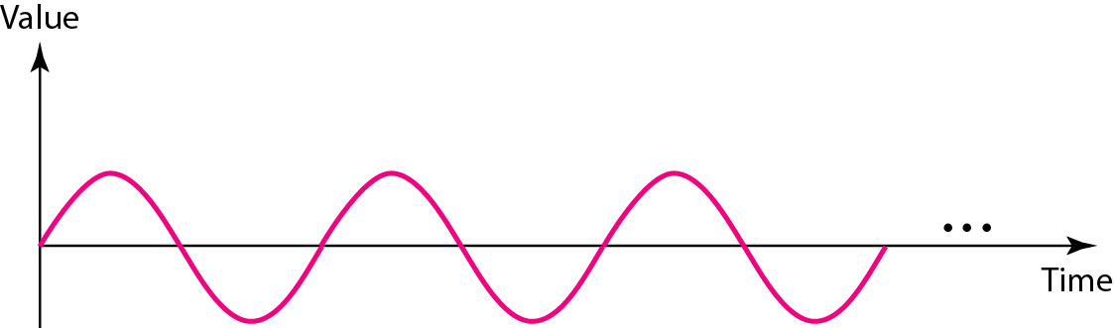
Figure 3.2 A sine wave
3.‹#›

Slide 10
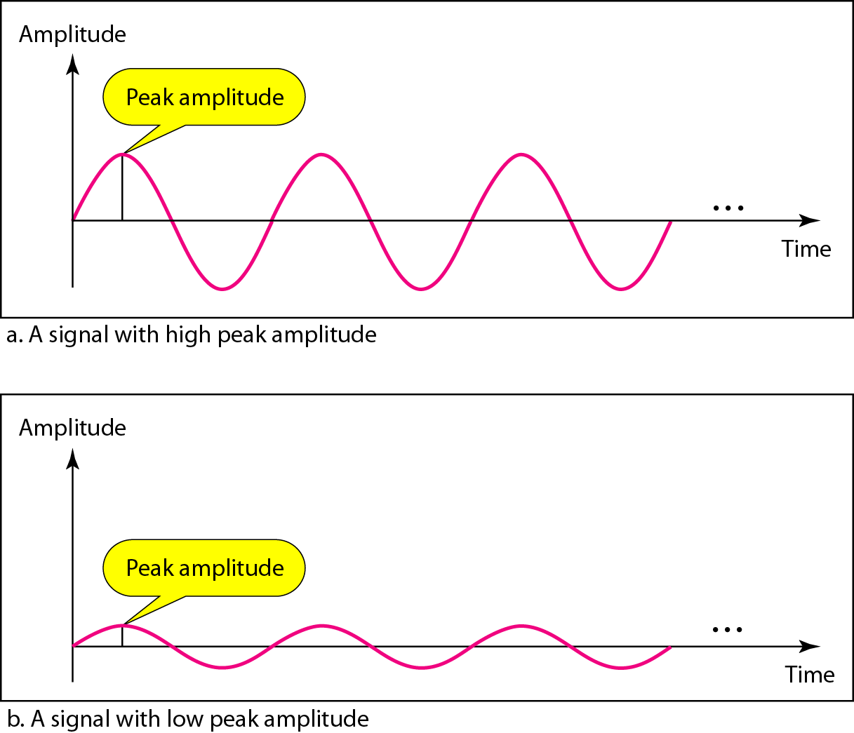
Figure 3.3 Two signals with the same phase and frequency,
but different amplitudes
3.‹#›

Slide 11

Note
Frequency and period are the inverse of each other.
3.‹#›

Slide 12
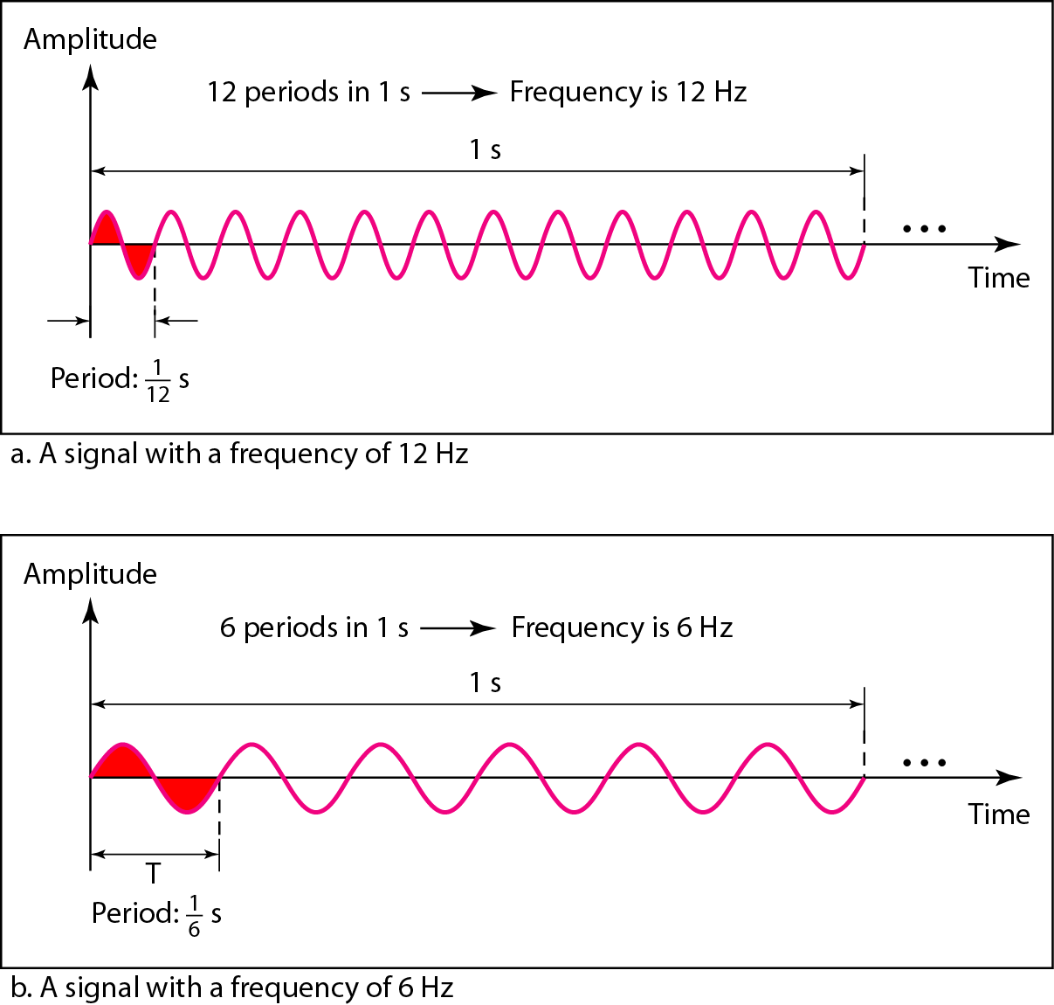
Figure 3.4 Two signals with the same amplitude and phase,
but different frequencies
3.‹#›

Slide 13
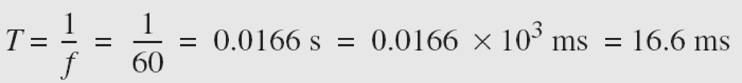
Example 3.3
The power we use at home has a frequency of 60 Hz. The period of this sine wave can be determined as follows:
3.‹#›

Slide 14
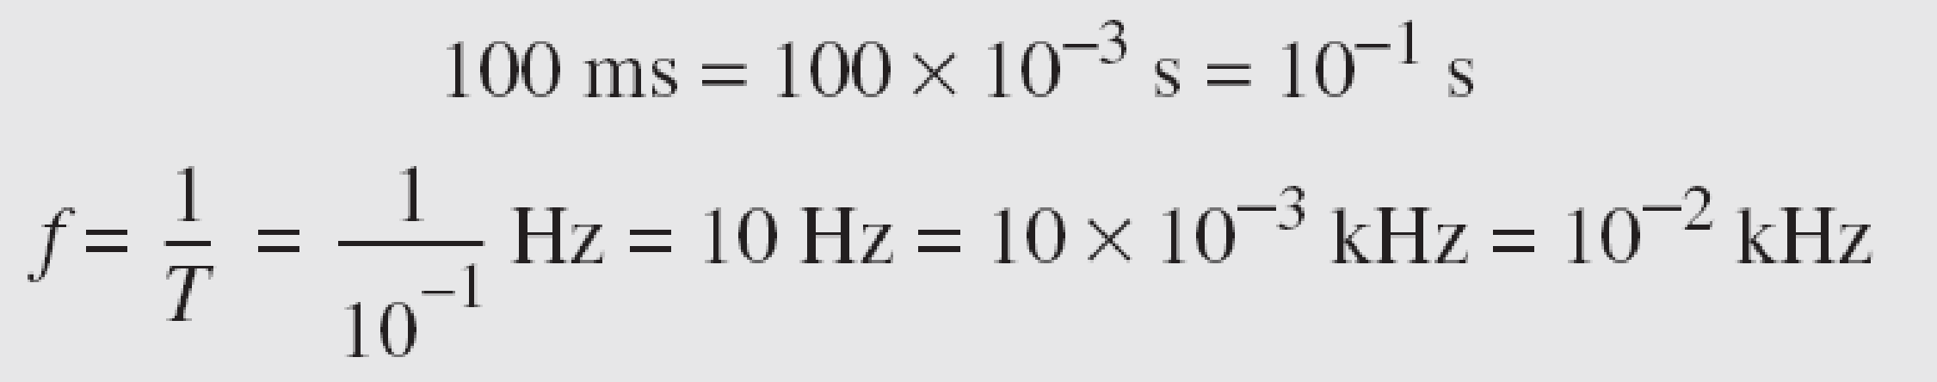
Example 3.5
The period of a signal is 100 ms. What is its frequency in kilohertz?
Solution
First we change 100 ms to seconds, and then we calculate the frequency from the period (1 Hz = 10⁻³ kHz).
3.‹#›

Slide 15
Note
Frequency is the rate of change with respect to time.
Change in a short span of time
means high frequency.
Change over a long span of
time means low frequency.
3.‹#›

Slide 16
Note
If a signal does not change at all, its frequency is zero.
If a signal changes instantaneously, its frequency is infinite.
3.‹#›

Slide 17
Note
Phase describes the position of the waveform relative to time 0.
3.‹#›

Slide 18
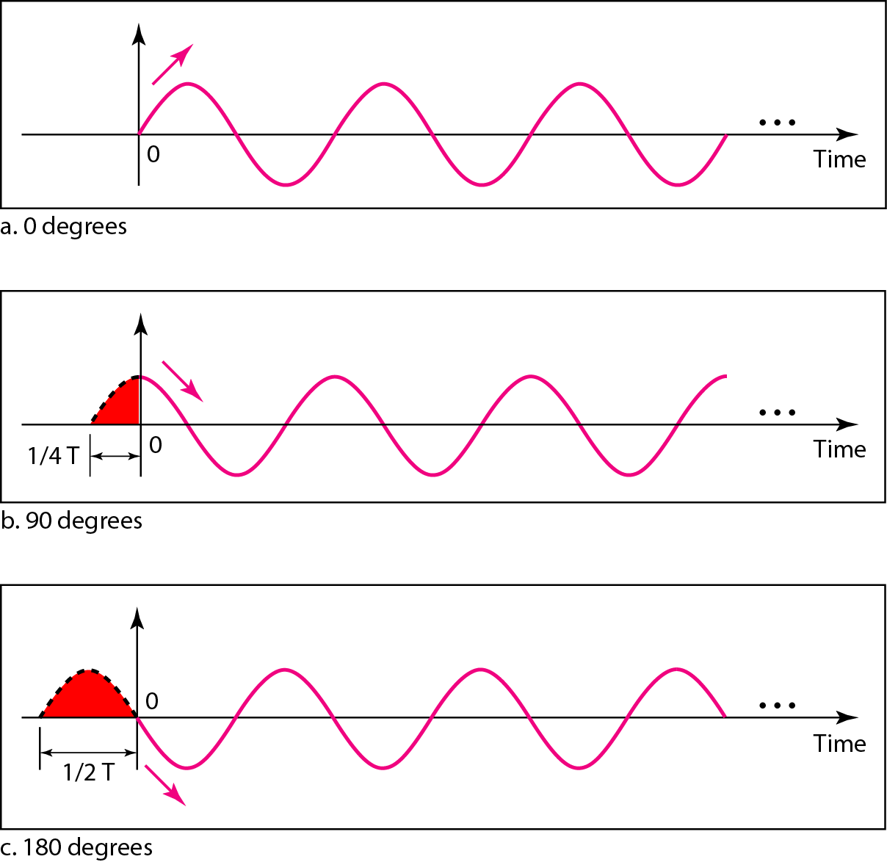
Figure 3.5 Three sine waves with the same amplitude and frequency,
but different phases
3.‹#›

Slide 19
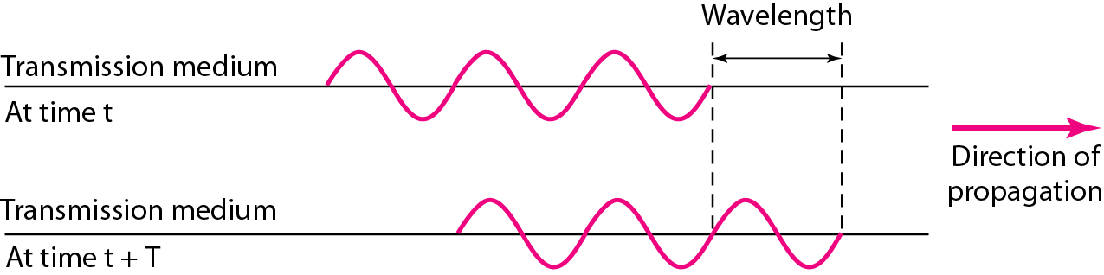
Figure 3.6 Wavelength and period
3.‹#›

Slide 20
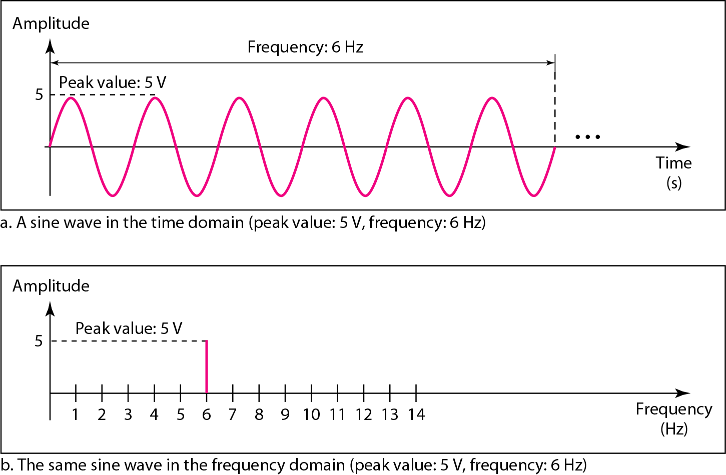
Figure 3.7 The time-domain and frequency-domain plots of a sine wave
3.‹#›

Slide 21
Example 3.7
The frequency domain is more compact and useful when we are dealing with more than one sine wave. For example, Figure 3.8 shows three sine waves, each with different amplitude and frequency. All can be represented by three spikes in the frequency domain.
3.‹#›

Slide 22
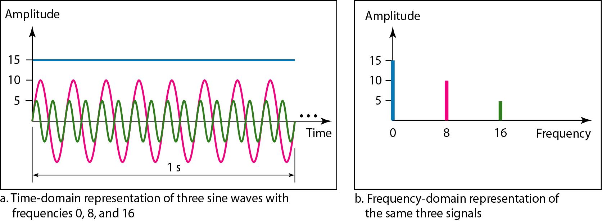
Figure 3.8 The time domain and frequency domain of three sine waves
3.‹#›

Slide 23
Note
A single-frequency sine wave is not useful in data communications;
we need to send a composite signal, a signal made of many simple sine waves.
3.‹#›

Slide 24
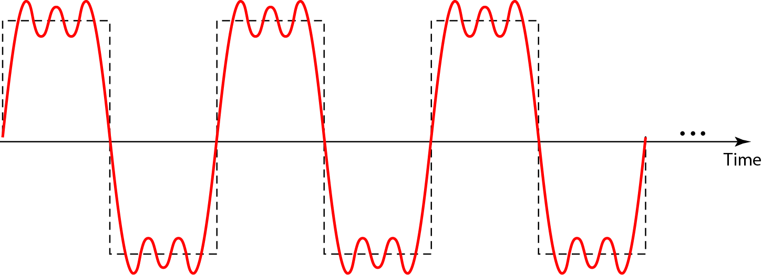
Figure 3.9 A composite periodic signal
3.‹#›

Slide 25
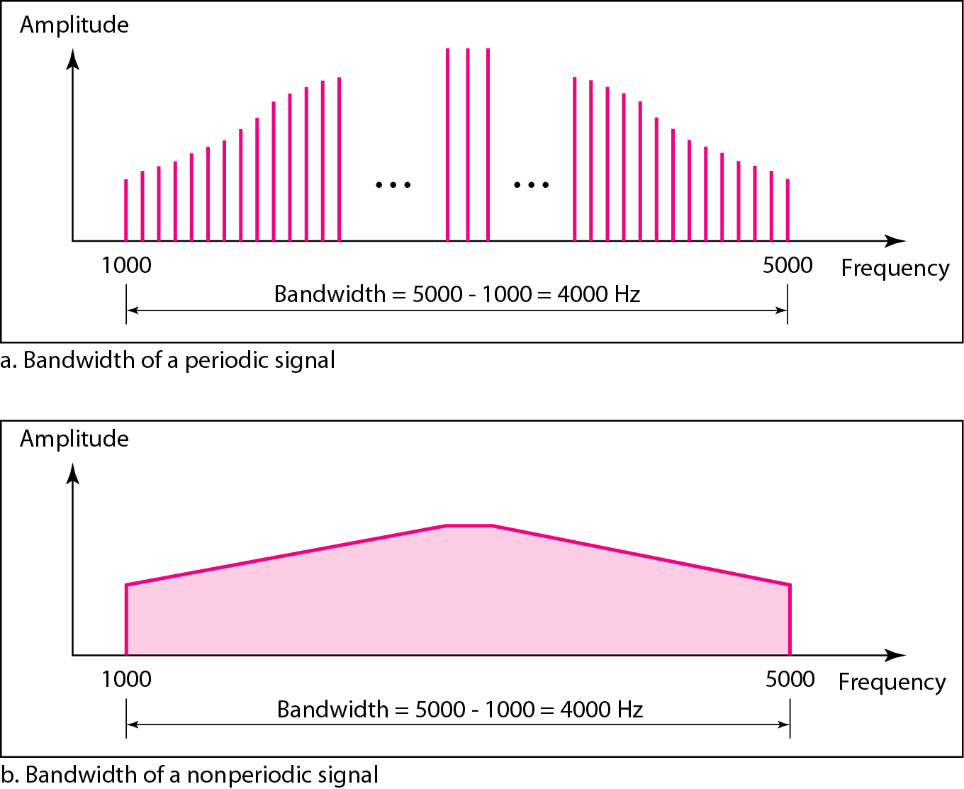
Figure 3.12 The bandwidth of periodic and nonperiodic composite signals
3.‹#›

Slide 26

Example 3.10
If a periodic signal is decomposed into five sine waves with frequencies of 100, 300, 500, 700, and 900 Hz, what is its bandwidth? Draw the spectrum, assuming all components have a maximum amplitude of 10 V.
Solution
Let f_{h} be the highest frequency, f_{l} the lowest frequency, and B the bandwidth. Then
The spectrum has only five spikes, at 100, 300, 500, 700, and 900 Hz (see Figure 3.13).
3.‹#›

Slide 27
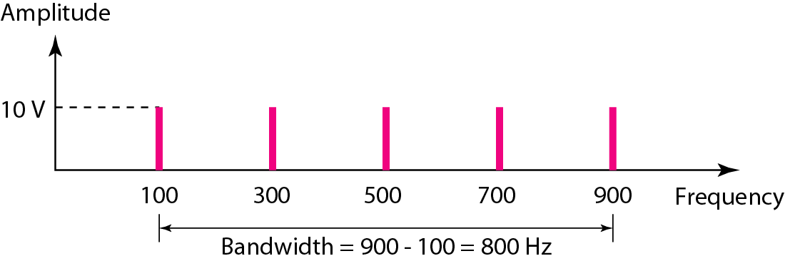
Figure 3.13 The bandwidth for Example 3.10
3.‹#›

Slide 28
3-3 DIGITAL SIGNALS
In addition to being represented by an analog signal, information can also be represented by a digital signal. For example, a 1 can be encoded as a positive voltage and a 0 as zero voltage. A digital signal can have more than two levels. In this case, we can send more than 1 bit for each level.
Topics discussed in this section:
Bit Rate
Bit Length
Digital Signal as a Composite Analog Signal
Application Layer
3.‹#›

Slide 29
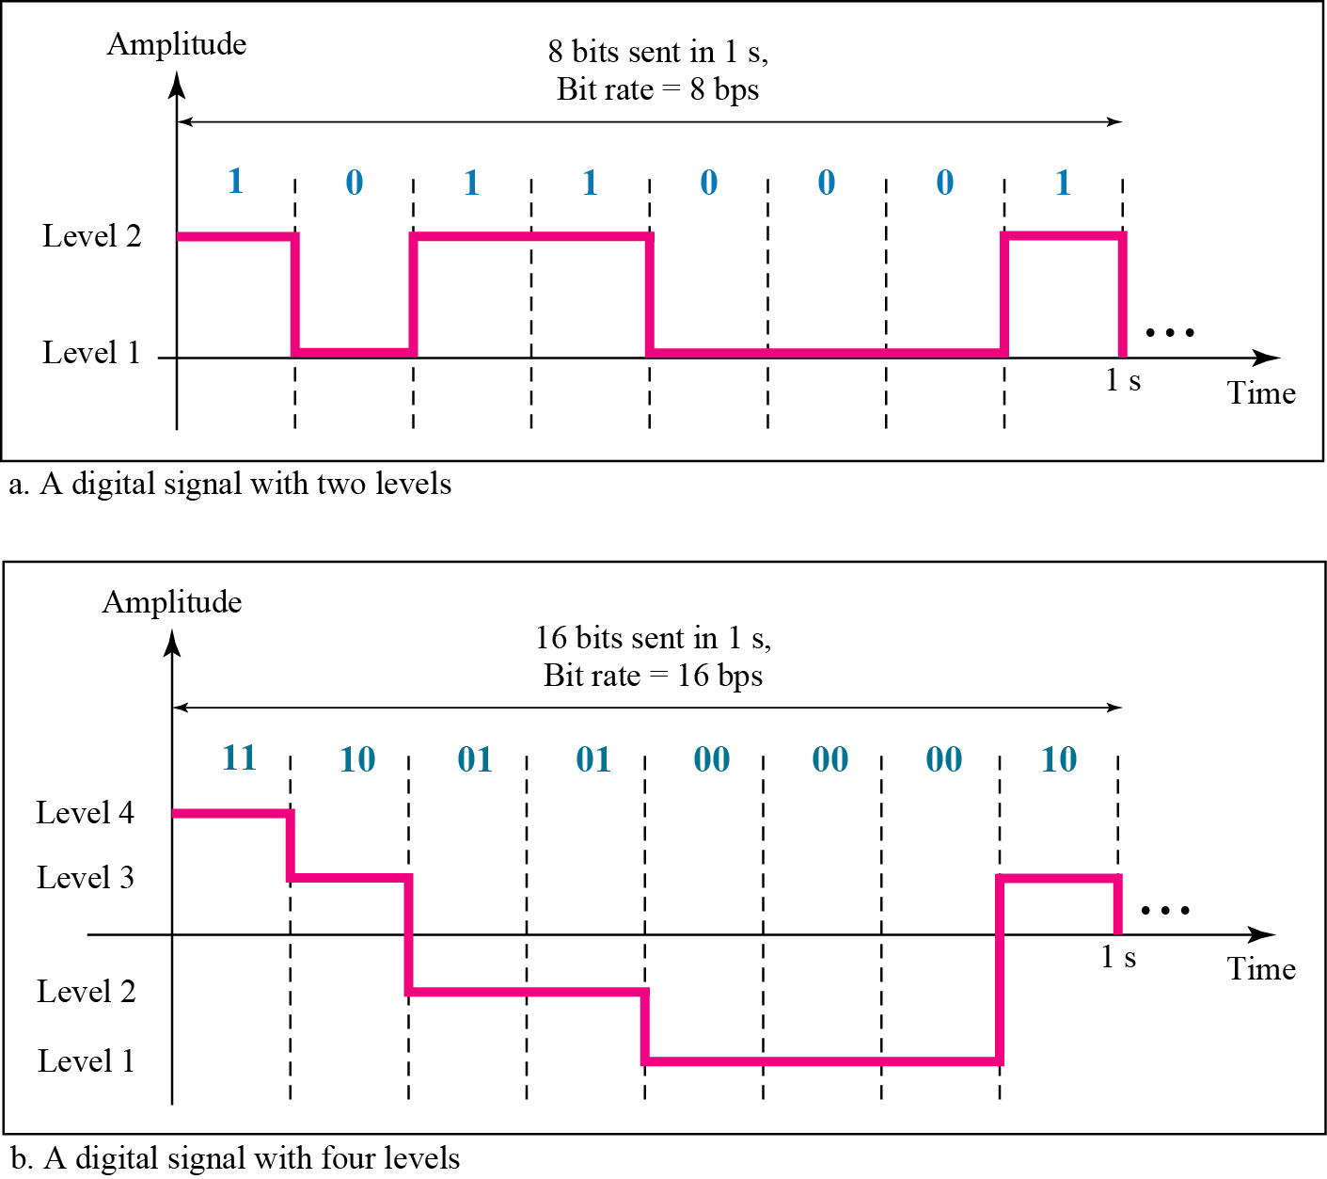
Figure: Two digital signals: one with two signal levels and the other
with four signal levels
Figure shows two signals, one with two levels and the other with four. We send 1 bit per level in part a of the figure and 2 bits per level in part b of the figure.
In general, if a signal has L levels, each level needs log₂L bits. For this reason, we can send log ₂4 = 2 bits in part b.
3.‹#›

Slide 30
Example 3.16
A digital signal has eight levels. How many bits are needed per level? We calculate the number of bits from the formula
Each signal level is represented by 3 bits.
3.‹#›

Slide 31
Digital Signal as Composite Analog Signal
3.‹#›

Slide 32
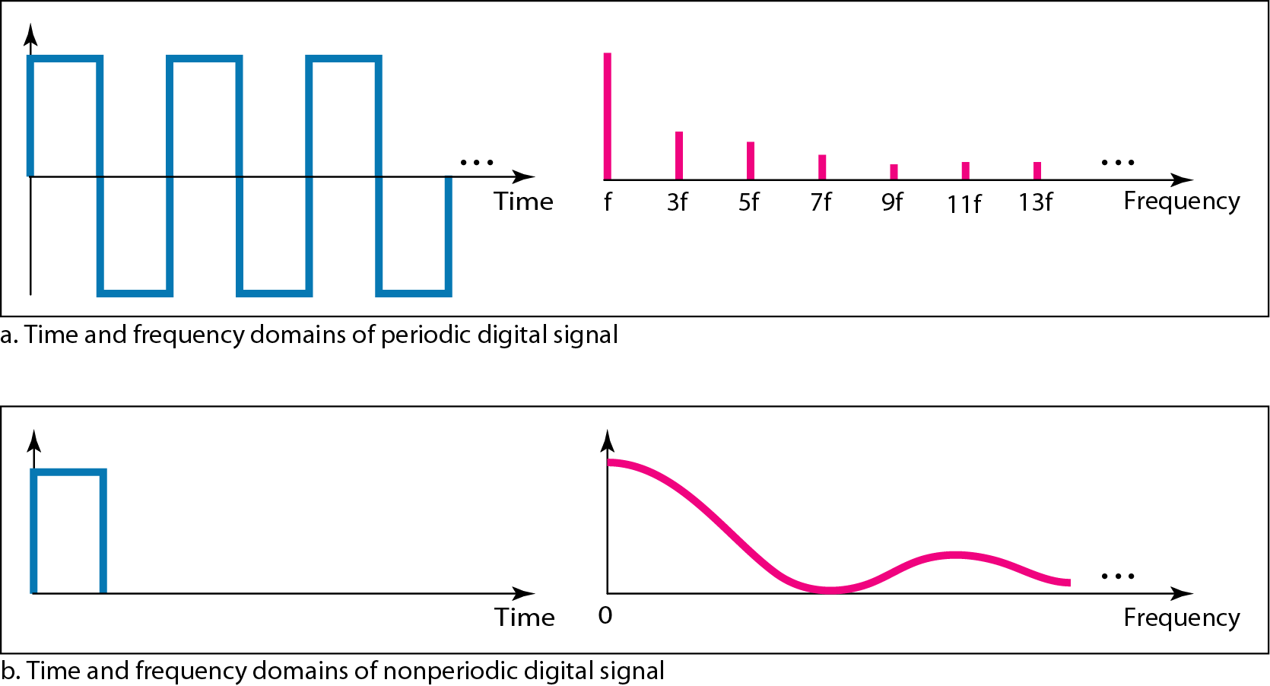
Figure 3.17 The time and frequency domains of periodic and nonperiodic digital signal
If the digital signal is periodic, which is rare in data communications, the decomposed signal has a frequency domain representation with an infinite bandwidth and discrete frequencies.
3.‹#›

Slide 33
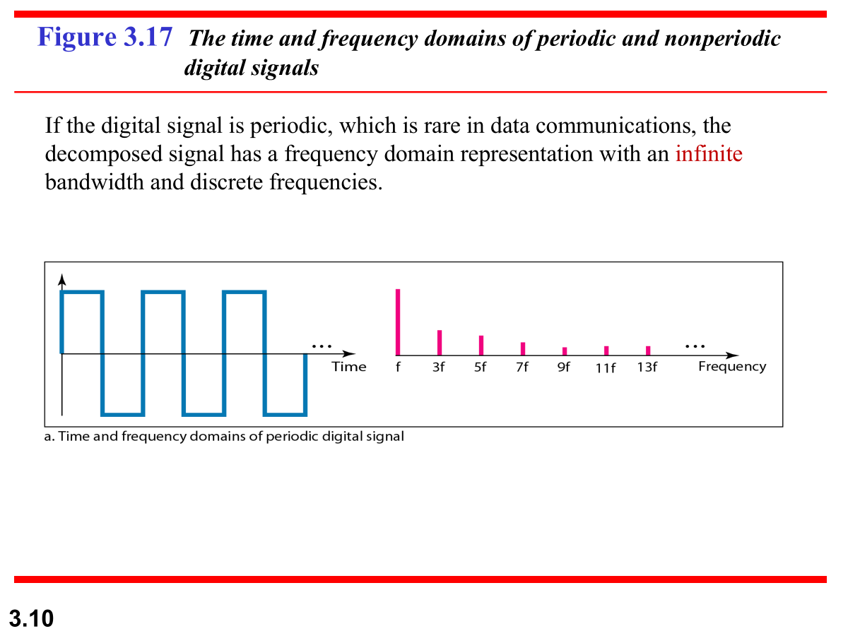
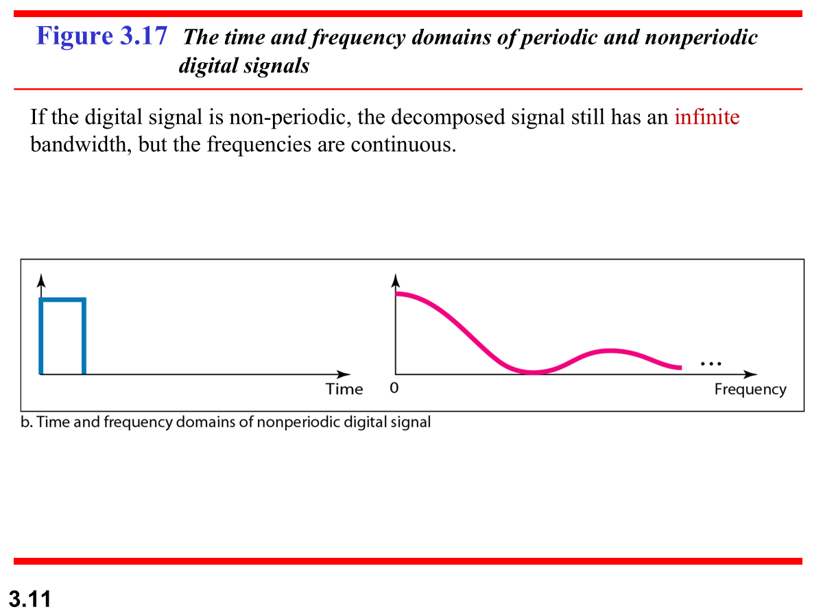
Figure 3.16 Two digital signals: one with two signal levels and the other
with four signal levels
3.‹#›

Slide 34
Figure 3.17 The time and frequency domains of periodic and nonperiodic digital signals
Note that both bandwidths are infinite, but the periodic signal has discrete frequencies while the non-periodic signal has continuous frequencies.
3.‹#›

Slide 35
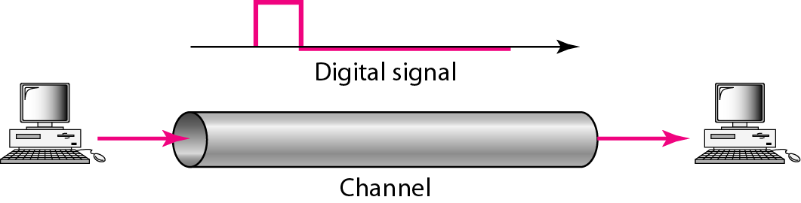
Transmission of digital signals
We can transmit a digital signal by one of two different approaches:
Baseband Transmission
Broadband Transmission(using modulation)
Baseband transmission means sending a digital signal over a channel without changing the digital signal to an analog signal.
Baseband transmission requires a low-pass channel, a channel with a bandwidth that starts from zero.

Slide 36
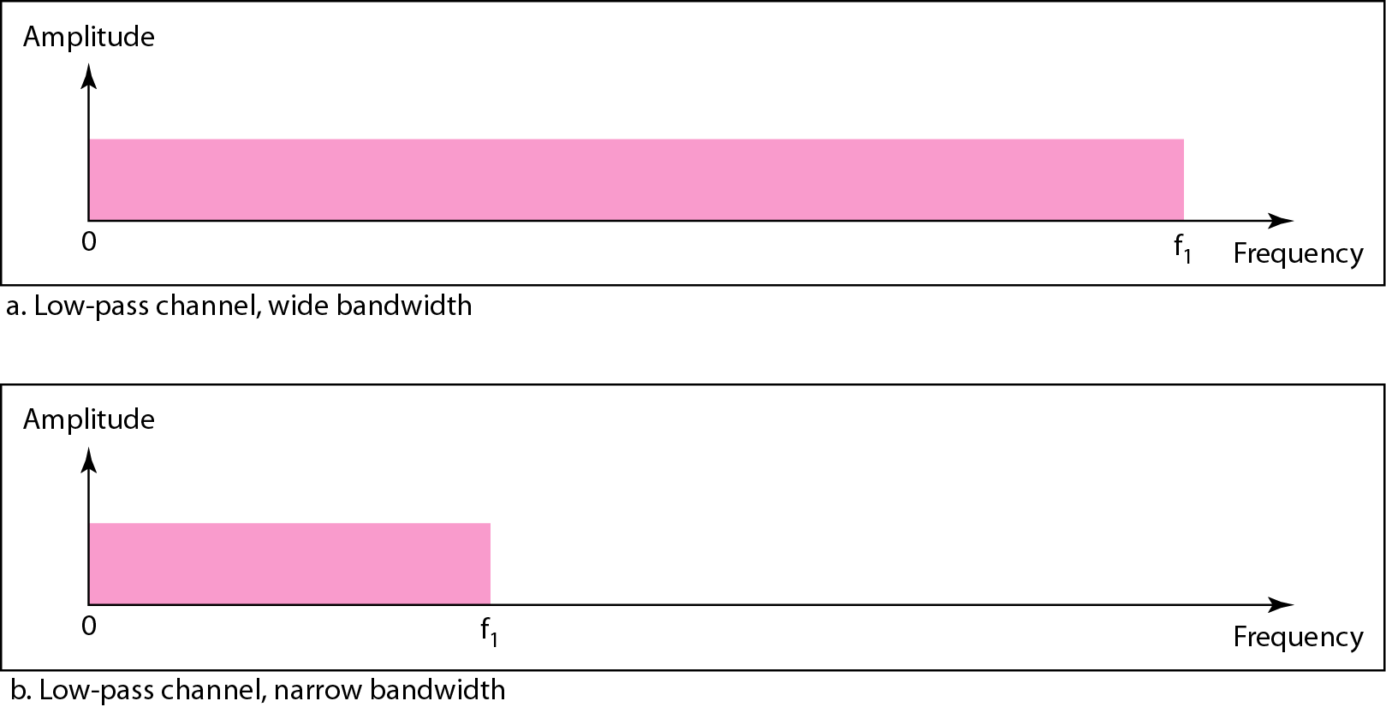
Figure: Bandwidths of two low-pass channels

Slide 37
_{Broadband Transmission}
Broadband transmission or modulation means changing the digital signal to an analog signal for transmission.
Modulation allows us to use a bandpass channel– a channel with a bandwidth that does not start from zero.
This type of channel is more available than a low-pass channel.
If the available channel is a bandpass channel, we cannot send the digital signal directly to the channel; we need to convert the digital signal to an analog signal before transmission.

Slide 38
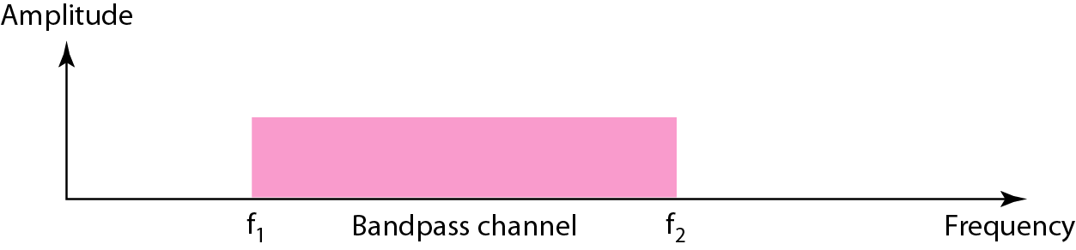
Figure: Bandwidth of a bandpass channel

Slide 39
Example: Low Pass Channel
We have a low-pass channel with bandwidth 200 kHz. What is the maximum frequency of this channel?
Solution:
Here, bandwidth, B = 200 kHz
We know, low-pass channel’s bandwidth starts from 0 Hz,
And bandwidth = highest frequency – lowest frequency
So, maximum frequency = 200 kHz
3.‹#›

Slide 40
Example 3.17
A digital signal has nine levels. How many bits are needed per level? We calculate the number of bits by using the formula. Each signal level is represented by 3.17 bits. However, this answer is not realistic. The number of bits sent per level needs to be an integer as well as a power of 2. For this example, 4 bits can represent one level.
3.‹#›

Slide 41
Example 3.18
Assume we need to download text documents at the rate of 100 pages per second. What is the required bit rate of the channel?
Solution
A page is an average of 24 lines with 80 characters in each line. If we assume that one character requires 8 bits, the bit rate is
3.‹#›

Slide 42
3-4 TRANSMISSION IMPAIRMENT
Signals travel through transmission media, which are not perfect. The imperfection causes signal impairment. This means that the signal at the beginning of the medium is not the same as the signal at the end of the medium. What is sent is not what is received. Three causes of impairment are attenuation, distortion, and noise.
Topics discussed in this section:
Attenuation
Distortion
Noise
3.‹#›

Slide 43
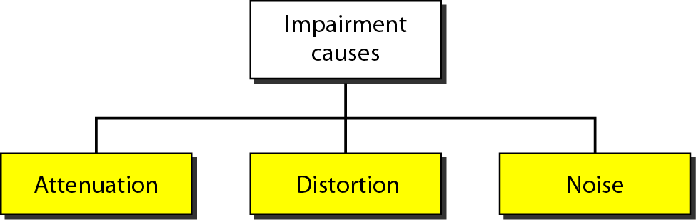
Figure 3.25 Causes of impairment
3.‹#›

Slide 44
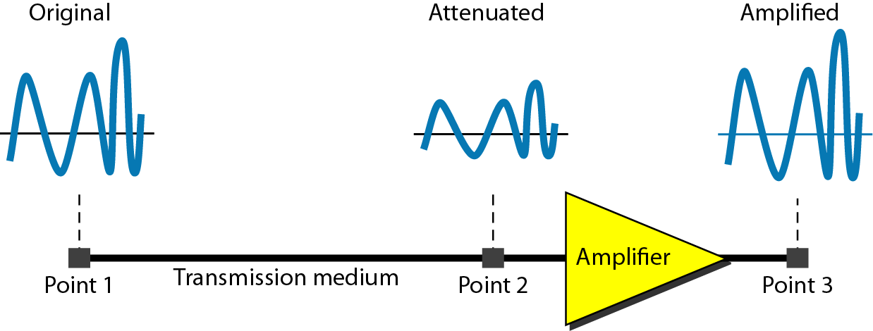
Attenuation
It means loss of energy -> weaker signal
When a signal travels through a medium it loses energy overcoming the resistance of the medium.
This is also known as attenuated signal.
Amplifiers are used to amplify the attenuated signal which gives the original signal back.
Loss of energy
3.‹#›

Slide 45
Figure 3.26 Attenuation
3.‹#›

Slide 46

Example 3.26
Suppose a signal travels through a transmission medium and its power is reduced to one-half. This means that P₂ is (1/2)P₁. In this case, the attenuation (loss of power) can be calculated as
A loss of 3 dB (–3 dB) is equivalent to losing one-half the power.
3.‹#›

Slide 47

Example 3.28
One reason that engineers use the decibel to measure the changes in the strength of a signal is that decibel numbers can be added (or subtracted) when we are measuring several points (cascading) instead of just two. In Figure 3.27 a signal travels from point 1 to point 4. In this case, the decibel value can be calculated as
3.‹#›

Slide 48

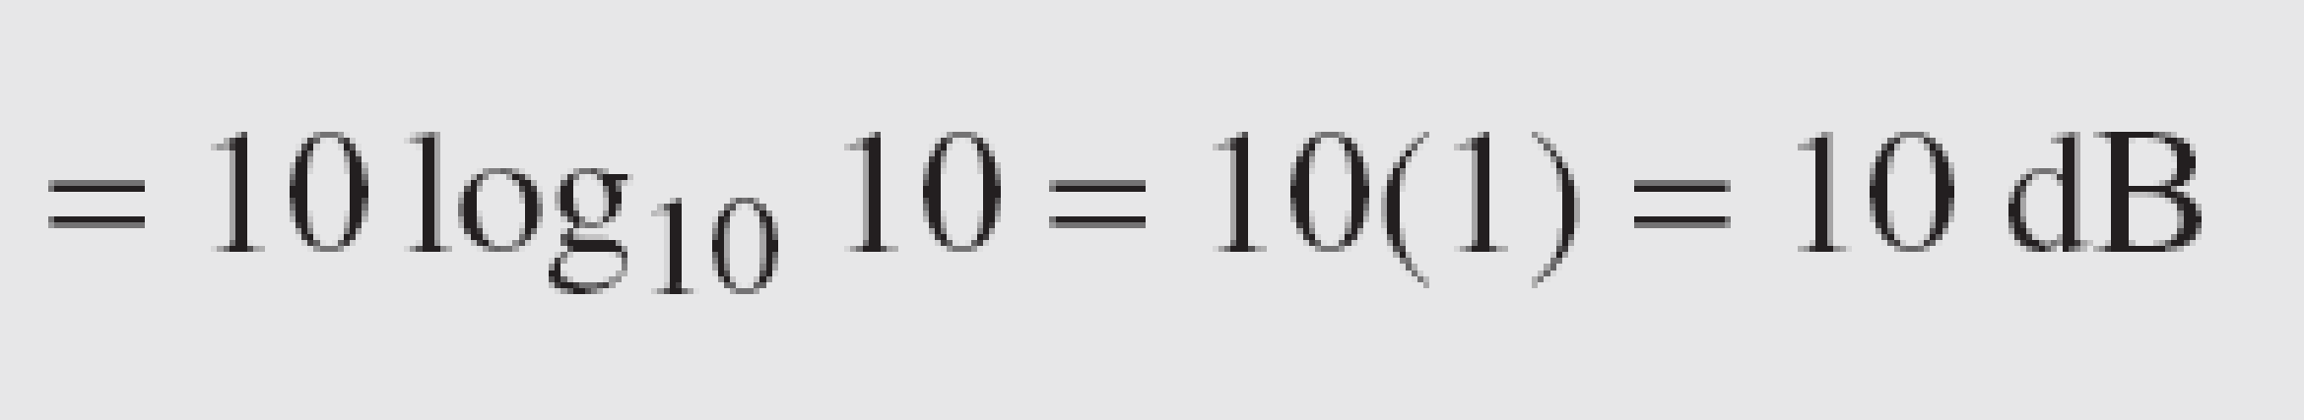
Example 3.27
A signal travels through an amplifier, and its power is increased 10 times. This means that P₂ = 10P₁ . In this case, the amplification (gain of power) can be calculated as
3.‹#›

Slide 49
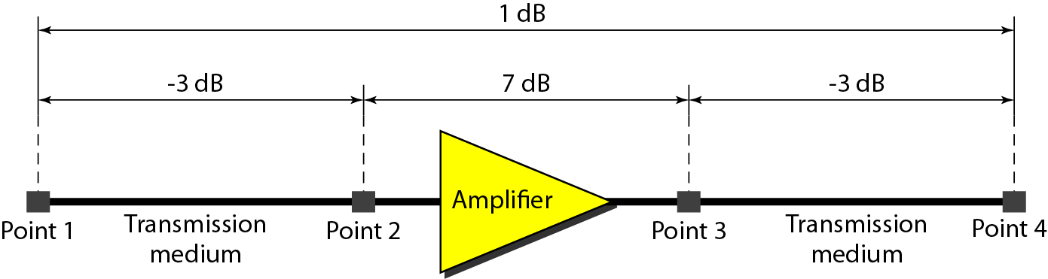
Figure 3.27 Decibels for Example 3.28
3.‹#›

Slide 50
Example : Attenuation
A fiber-optic communication system transmits data from a source to a destination 12 km away. The input power at the transmitter is 5 mW, and the attenuation coefficient of the fiber is 0.2 dB/km.
Find the total attenuation (in dB) over the 12 km fiber length.
Calculate the output power (in mW) at the receiver.
Solution:
(A) Total attenuation over 12 km fiber length = 0.2*12 = -2.4 dB
3.‹#›

Slide 51
Example : Attenuation
(B) Calculate the output power (in mW) at the receiver.
Solution:
P1= 5 mW
P2=?
gain/loss =10log₁₀(P2/P1)
-2.4 =10log₁₀(P2/5)
P2 = 2.877 mW
3.‹#›

Slide 52
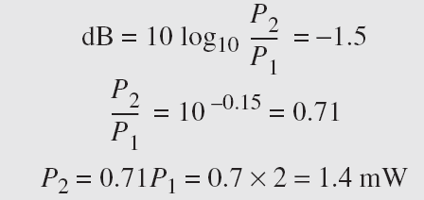
Example 3.30
The loss in a cable is usually defined in decibels per kilometer (dB/km). If the signal at the beginning of a cable with −0.3 dB/km has a power of 2 mW, what is the power of the signal at 5 km?
Solution
The loss in the cable in decibels is 5 × (−0.3) = −1.5 dB. We can calculate the power as

Slide 53
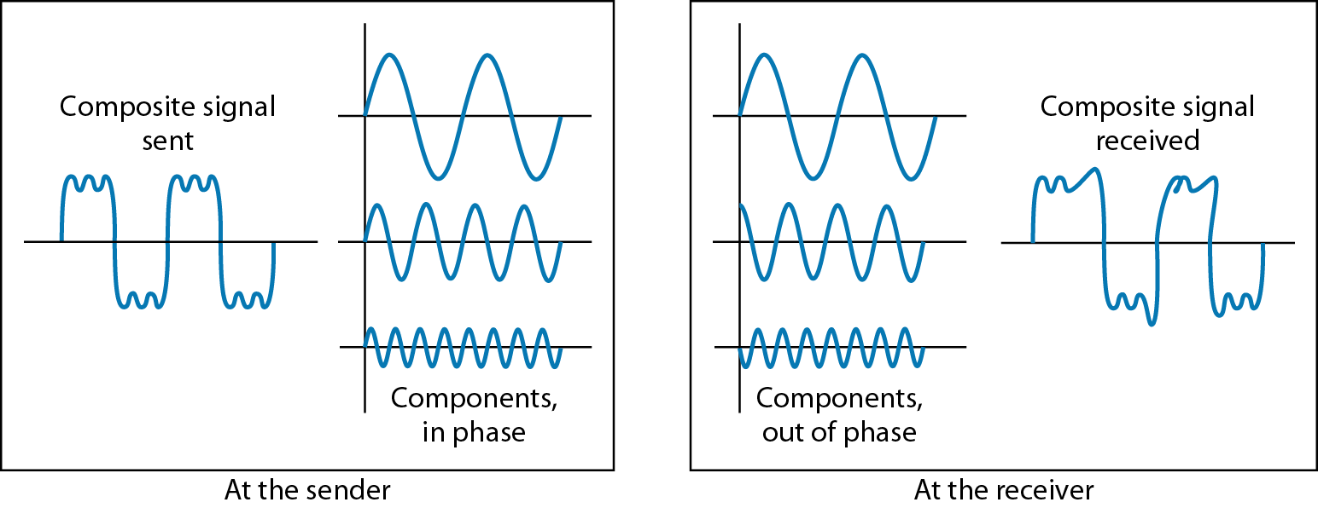
Distortion
It means change in the shape of signal.
Distortion occurs in composite signals with different frequencies.
Each frequency component has its own propagation speed traveling through a medium.
The different components therefore arrive with different delays at the receiver.
That means that the signals have different phases at the receiver end from what they had at sender's end.
changes in the form or shape of the signal
3.‹#›

Slide 54
Noise
The random or unwanted signal that mixes up with the original signal is called noise.
There are different types of noise
  Thermal - noise random movement of electrons in the wire creates an extra signal
  Induced – comes from sources such as motors and appliances. These devices act as sending antenna and transmission medium act as receiving antenna.
  Crosstalk – when one wire affects the other wire.
  Impulse - Spikes that result from power lines, lightning, or comes from high energy etc.
3.‹#›

Slide 55
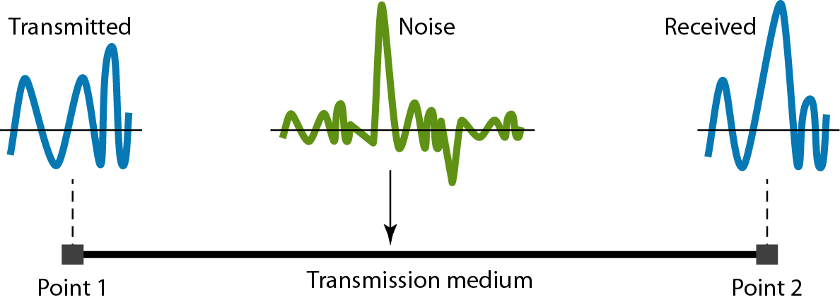
Noise
unwanted signal that mixes up with the original signal
3.‹#›

Slide 56
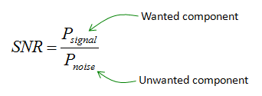


_{Signal to Noise Ratio (SNR)}
To measure the quality of a system the SNR is often used. It indicates the strength of the signal with the noise power in the system.
SNR is actually the ratio of what is wanted (signal) to what is not wanted (noise).
A high SNR means the signal is less corrupted by noise; a low SNR means the signal is more corrupted by noise.
It is the ratio between two powers.
It is usually described in dB unit and referred to as SNR_{dB.}

Slide 57
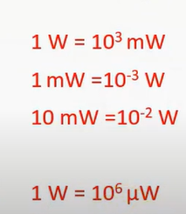
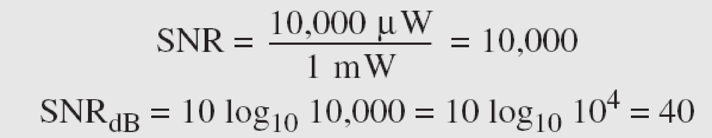
Example 3.31
The power of a signal is 10 mW and the power of the noise is 1 μW; what are the values of SNR and SNR_{dB} ?
Solution
The values of SNR and SNR_{dB} can be calculated as follows:
3.‹#›

Slide 58
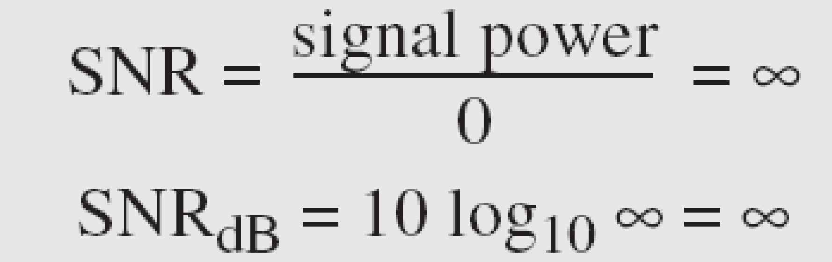
Example 3.32
The values of SNR and SNR_{dB} for a noiseless channel are
We can never achieve this ratio in real life; it is an ideal.
3.‹#›

Slide 59
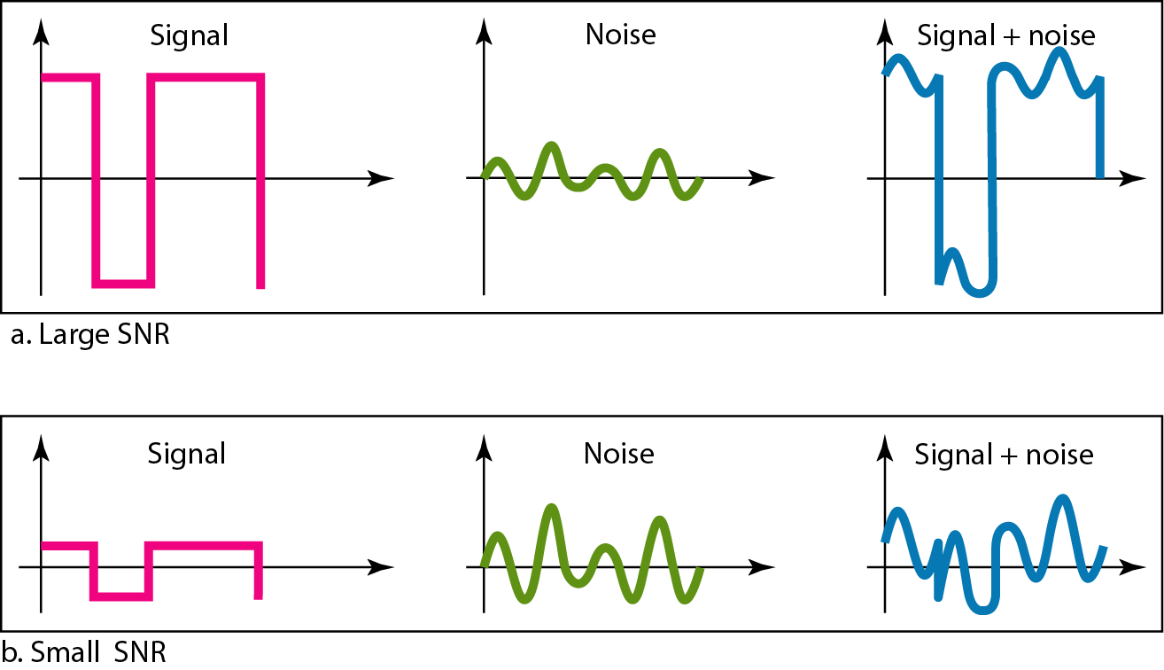
Figure 3.30 Two cases of SNR: a high SNR and a low SNR
3.‹#›

Slide 60
3-5 DATA RATE LIMITS
A very important consideration in data communications is how fast we can send data, in bits per second, over a channel. Data rate depends on three factors:
1. The bandwidth available
2. The level of the signals we use
3. The quality of the channel (the level of noise)
Topics discussed in this section:
Noiseless Channel: Nyquist Bit Rate
Noisy Channel: Shannon Capacity
Using Both Limits
3.‹#›

Slide 61
Note
Increasing the levels of a signal may reduce the reliability of the system.
3.‹#›

Slide 62
Noiseless Channel: Nyquist Bit Rate
Bit Rate = 2* Bandwidth*log₂L
3.‹#›

Slide 63
Example 3.34
Consider a noiseless channel with a bandwidth of 3000 Hz transmitting a signal with two signal levels. The maximum bit rate can be calculated as
3.‹#›

Slide 64
Example 3.35
Consider the same noiseless channel transmitting a signal with four signal levels (for each level, we send 2 bits). The maximum bit rate can be calculated as
3.‹#›

Slide 65

Example 3.36
We need to send 265 kbps over a noiseless channel with a bandwidth of 20 kHz. How many signal levels do we need?
Solution
We can use the Nyquist formula as shown:
Since this result is not a power of 2, we need to either increase the number of levels or reduce the bit rate. If we have 128 levels, the bit rate is 280 kbps. If we have 64 levels, the bit rate is 240 kbps.
3.‹#›

Slide 66
Noisy Channel: Shannon Capacity
Bitrate/ Capacity = B log₂ (1+SNR)
3.‹#›

Slide 67
Example 3.37
Consider an extremely noisy channel in which the value of the signal-to-noise ratio is almost zero. In other words, the noise is so strong that the signal is faint. For this channel the capacity C is calculated as
This means that the capacity of this channel is zero regardless of the bandwidth. In other words, we cannot receive any data through this channel.
3.‹#›

Slide 68
Example 3.38
We can calculate the theoretical highest bit rate of a regular telephone line. A telephone line normally has a bandwidth of 3000. The signal-to-noise ratio is usually 3162. For this channel the capacity is calculated as
This means that the highest bit rate for a telephone line is 34.860 kbps. If we want to send data faster than this, we can either increase the bandwidth of the line or improve the signal-to-noise ratio.
3.‹#›

Slide 69
Example 3.39
The signal-to-noise ratio is often given in decibels. Assume that SNR_{dB} = 36 and the channel bandwidth is 2 MHz. The theoretical channel capacity can be calculated as
3.‹#›

Slide 70


Example 3.40
For practical purposes, when the SNR is very high, we can assume that SNR + 1 is almost the same as SNR. In these cases, the theoretical channel capacity can be simplified to
For example, we can calculate the theoretical capacity of the previous example as
3.‹#›

Slide 71
Example 3.41
We have a channel with a 1-MHz bandwidth. The SNR for this channel is 63. What are the appropriate bit rate and signal level?
Solution
First, we use the Shannon formula to find the upper limit.
3.‹#›

Slide 72
Example 3.41 (continued)
The Shannon formula gives us 6 Mbps, the upper limit. For better performance we choose something lower, 4 Mbps, for example. Then we use the Nyquist formula to find the number of signal levels.
3.‹#›

Slide 73
Note
The Shannon capacity gives us the upper limit; the Nyquist formula tells us how many signal levels we need.
3.‹#›

Slide 74
3-6 PERFORMANCE
One important issue in networking is the performance of the network—how good is it? We discuss quality of service, an overall measurement of network performance, in greater detail in Chapter 24. In this section, we introduce terms that we need for future chapters.
Topics discussed in this section:
Bandwidth
Throughput
Latency (Delay)
3.‹#›

Slide 75
Note
In networking, we use the term bandwidth in two contexts.
❏ The first, bandwidth in hertz, refers to
the range of frequencies in a
composite signal or the range of
frequencies that a channel can pass.
❏ The second, bandwidth in bits per
second, refers to the speed of bit
transmission in a channel or link.
3.‹#›

Slide 76
Example 3.42
The bandwidth of a subscriber line is 4 kHz for voice or data. The bandwidth of this line for data transmission
can be up to 56,000 bps using a sophisticated modem to change the digital signal to analog.
3.‹#›

Slide 77

Example 3.44
A network with bandwidth of 10 Mbps can pass only an average of 12,000 frames per minute with each frame carrying an average of 10,000 bits. What is the throughput of this network?
Solution
We can calculate the throughput as
The throughput is almost one-fifth of the bandwidth in this case.
3.‹#›

Slide 78
Example 3.46
What are the propagation time and the transmission time for a 2.5-kbyte message (an e-mail) if the bandwidth of the network is 1 Gbps? Assume that the distance between the sender and the receiver is 12,000 km and that light travels at 2.4 × 10⁸ m/s.
Total delay = Transmission delay + Queueing delay + Processing delay + Propagation delay
Solution
We can calculate the propagation and transmission time as shown on the next slide:
3.‹#›

Slide 79
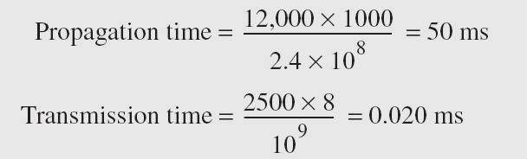
Example 3.46
Propagation delay = Distance/propagation speed
Transmission delay = Data size/ bandwidth
Note that in this case, because the message is short and the bandwidth is high, the dominant factor is the propagation time, not the transmission time. The transmission time can be ignored.
3.‹#›

Slide 80
_{END}
3.‹#›

